Slide 1
Architecture Transformation with CycleGAN
Cognitive Computing, Spring 2019

Slide 2
Agenda
Problem Statement
Data Description
Methodology
Results
Project Value

Slide 3
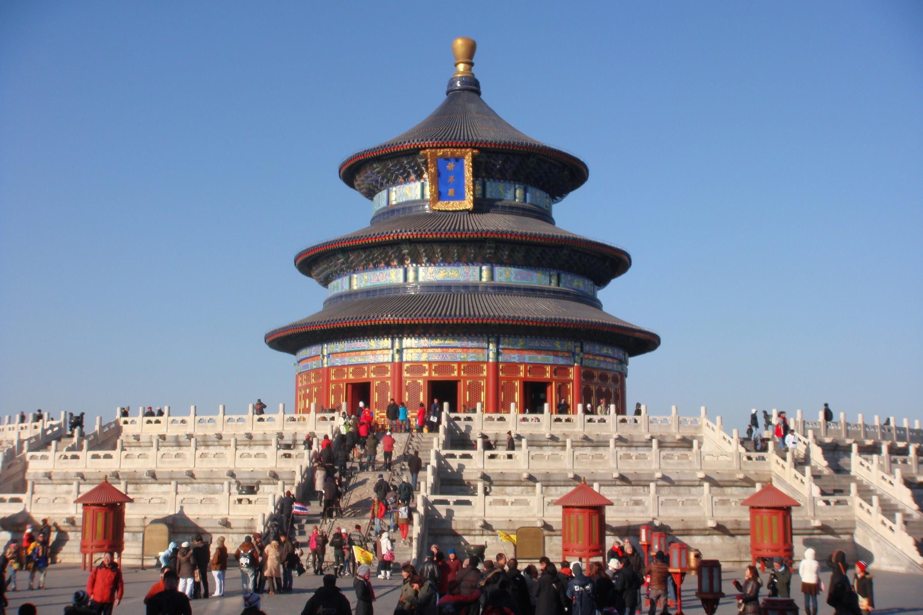
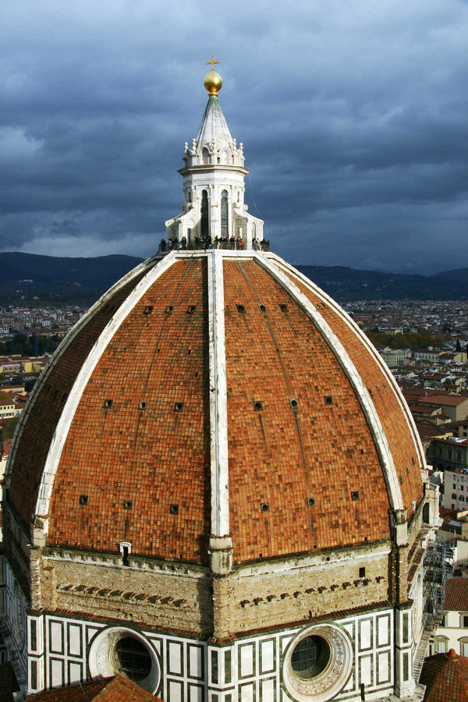
Problem Statement
Find the mapping between unpaired architecture pictures from China and Europe and recreate the pictures with swapped styles using CycleGAN network.

Slide 4
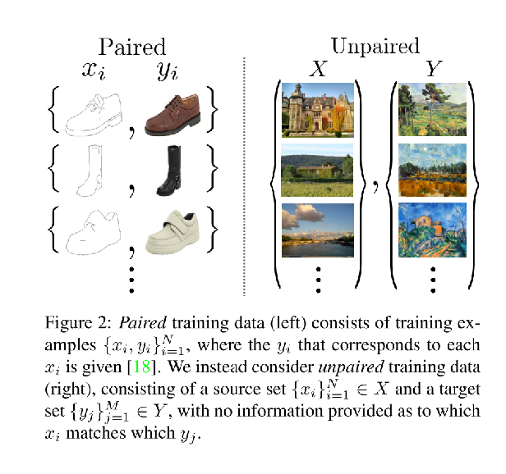
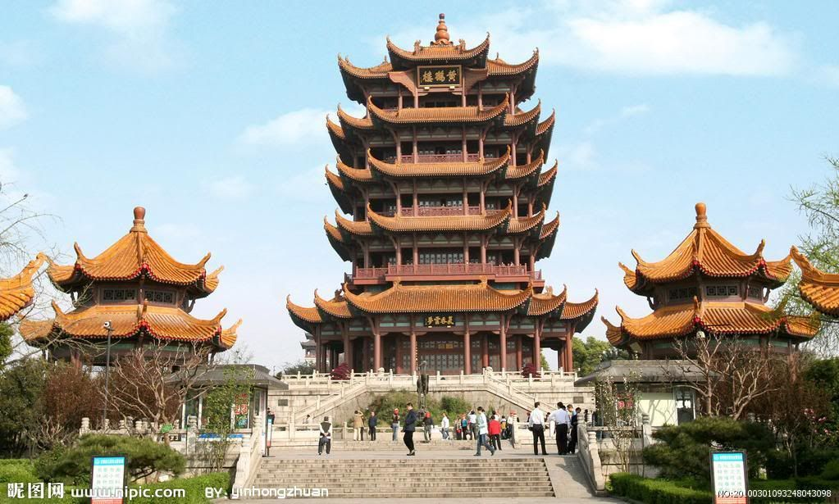
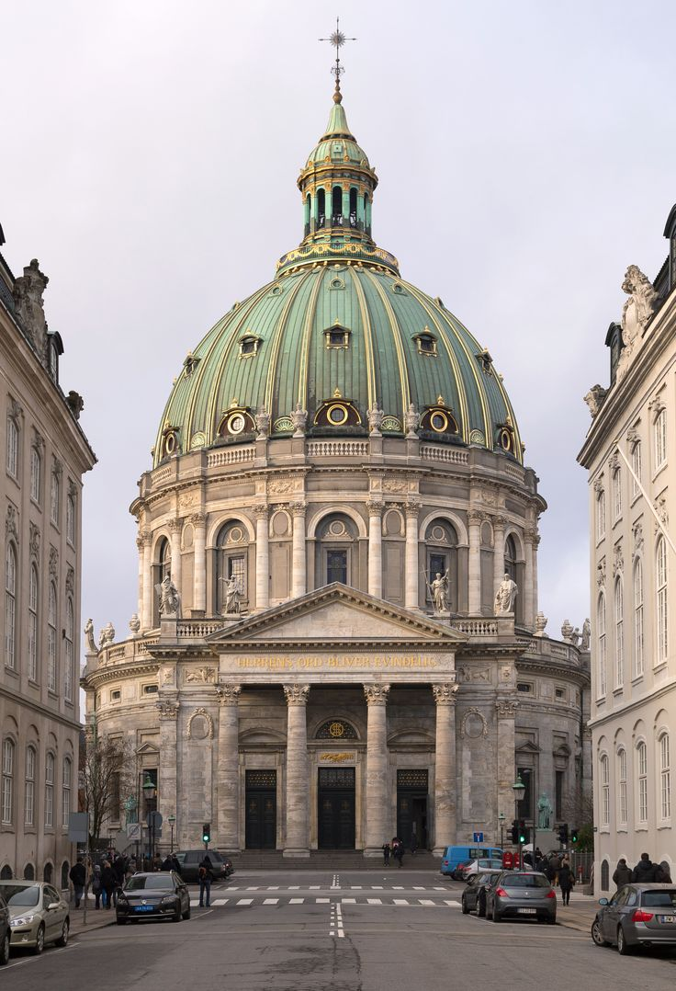
Data Description
The Pix2Pix network requires paired translations, which means that while training, for each input, you need to specify exactly what the output should look like. CycleGAN instead just requires two unpaired collections of images and will do its best to find the mapping between them, without you having to specify what the pairs are.
Notes:
CycleGAN builds on earlier work called Pix2Pix.

Slide 5
Methodology
Environment: Google Colab + GPU
Model: Cycle-Consistent Adversarial Networks (CycleGAN)
1
2
3
4
5
Generators
Discriminators
Optimizer
Batch Generator
Training
Three major components: an encoder, transformer, and decoder
Take as input an image and then output a single value
The idea here is the discriminator should still be able to say that older generated images are fake.
Two kinds of batch generators to help you get data into your CycleGAN network
Part of training
Notes:
This network essentially trains 2 autoencoders using a set of 2 generators (G and F in the images above) and 2 discriminators (D_X and D_Y in the images above) . The idea is pretty easy to grasp if you are already familiar with generative adversarial networks, and most of the tricky bits are in the details of implementation.
The Generator is slightly different though. Instead of starting with a random feature vector of say 100 values, we'll actually start with an image and then compose something not unlike an Autoencoder. The structure of this Autoencoder is a little different. We'll have three major components: an encoder, transformer, and decoder.
The encoder is composed of a few convolutional layers with stride 2 which will downsample the image with each layer. The authors create it with 3 layers, and use padding on the first layer.

Slide 6
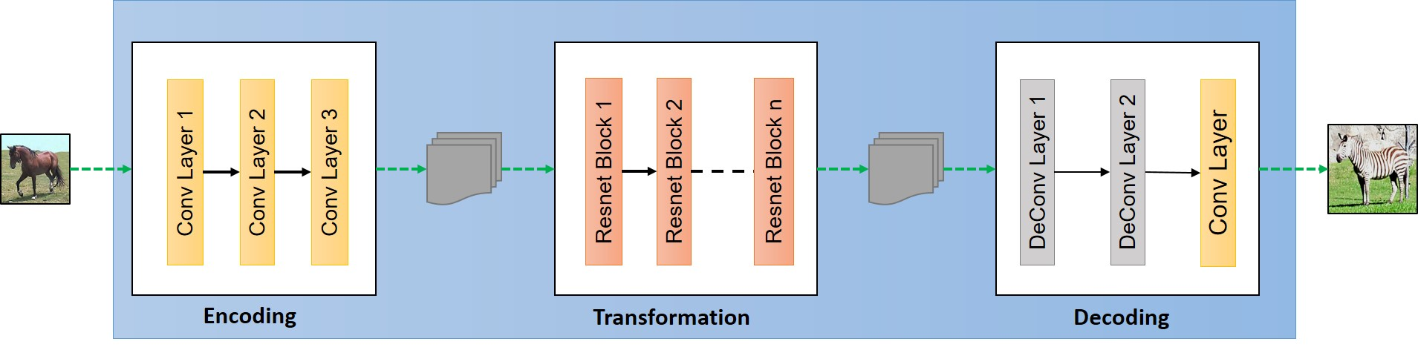
Generator
Network | Stride | Convolution | Activation Function | Filters
Encoding | 1, 2, another 2 | 7x7, 3x3, 3x3 | Leaky ReLU | 128
Transformation | Single stride | 3x3 | Leaky ReLU | 128
Decoding | 2, 2, and 1 | 3x3, 3x3, 7x7 | Last: Tanh | 128
Notes:
Now let's write a function for the encoder, following the CycleGAN architecture. We want a padding layer, then 3 convolutional layers with strides 1, then 2, then another 2. The first convolutional layer will have a 7x7 convolution, and the rest will be 3x3. Also, we'll initialize the weights to a standard deviation of 0.02 using a normal distribution. For an activation function, we'll be using a Leaky ReLu with 0.2 leakage. We'll also exponentially increase the number of filters with each layer, starting with 32, then going to 64 and finally 128. Lastly, we'll also use something like batch normalization called instance normalization, and use the TensorFlow layers module to do the entire convolution operation for us in a single convenient function:
L1-Loss between cycle and real images
The next part of the Generator is the Transformer. These are going to be 6 or 9 Residual Blocks, which is a really powerful module that comes up a lot in almost every new architecture out there. Instead of simply having a convolutional layer, we'll have a convolutional layer and then sum together the original output. So it's a sort of residual function of the input which should be learned, residual meaning what's left over. The residual blocks allow the base activation to persist, but then learns a simple addition on top of that layer. This is useful because it ensures the original activation has a path to the output. And similarly, it is useful for backpropagation since the gradient has less chance of exploding or vanishing, as they typically can do in very deep networks. To read more about residual networks, check the original paper which shows how to create a network of 1000s of layers, all without having issues with vanishing or exploding gradients!
Alright let's code up the residual block. All the convolutions are going to be single stride, and 128 channels. Each block will have a pad layer, a 3x3 convolution with Leaky ReLu and Instance Normalization, another pad layer, another convolution with Instance Normalization, except no nonlinearity, and then an addition with the starting activation.
Great, now the last piece we need to code up our Generator is the Decoder. This is basically going to do the complete opposite of our Encoder. We'll have three deconvolutional layers with stride 2, stride 2, and stride 1, and kernel sizes 3, 3, and 7. Before the last layer we'll also pad to avoid boundary artifacts with the larger 7x7 kernel, and our last activation will be a tanh, meaning our images will be in the range of -1 and 1. Generally this is an ideal normalization for images as it means the starting point is basically a grey image. We'll need to keep this in mind when we feed our data into the network and ensure we are using images in the same range.

Slide 7
Discriminator
If true image, then 1
Image
If false image, then 0
256*256 pixel image
5 convolutional layers( 2 strides in first three, 1 stride in last 2)
Average discriminators on the resulting map layer
Sigmoid activation function
Single channel output
Notes:
other major component is the Discriminator. This network will take as input an image and then output a single value. In the case of a true image, it should output 1, and in the case of a false image, it should output 0. In any case, the discriminator should saturate at 0 or 1, so will need a sigmoid as its final activation. The network will take as input a 256 x 256 pixel image and use a series of 5 convolutional layers not unlike the ones we've already used. The first three layers will be stride 2, and then the last 2 will be stride 1. We'll increase the number of outputs exponentially until the last layer which will have a single channel as output.
This network doesn't actually reduce down the image to a single value, but instead will reduce down the 256 x 256 pixel image to a spatial map with 1 channel as output. The resulting map effectively has individual discriminators which we average together to get the final result. The authors show a few possible combinations of stride and layer sizes to get effectively different receptive field sizes in the final layer, and show that this combination of 5 layers seems to have the best performance and a receptive field size of 70.
Squared loss between fake/recreated and real images

Slide 8
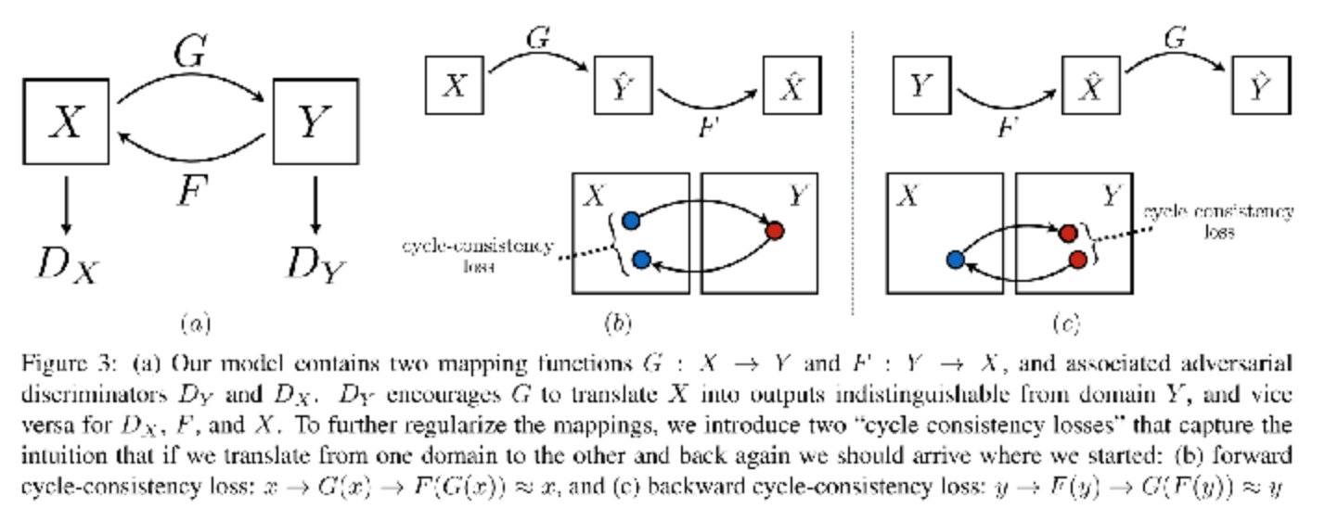
Optimizer
Generator: Update G_xy, G_yx
Discriminator: Update D_X and D_Y
Notes:
Just like in the original GAN implementation, we'll create individual optimizers which can only update certain parts of the network. The original GAN had two optimizers, one for the generator and one for the discriminator. Even though the discriminator depends on input from the generator, we would only optimize the variables belonging to the discriminator when training the discriminator. If we did not do this, we'd be making the generator worse, when what we really want to happen is for both networks to get better. We'll do the same thing here, except now we actually have 3 networks to optimize, and so we'll need 3 optimizers: G_xyand G_yx variables will be optimized as the generator, while D_X, and D_Y, should update two different discriminators.

Slide 9
Batch Generator & Train
Two Types to input our data:
Take X and Y image collections as arrays
Take a single image for X and Y then randomly crop it with min_size and max_size to determine what can be cropped and what the crop should be reshaped to
Training: The last part is to fit the model on our dataset
Notes:
Finally, we're almost ready to train. We just need data! The most important part! I've included two kinds of batch generators to help you get data into your CycleGAN network. One takes your X and Y image collections as arrays. The other takes a single image for X and Y and will randomly crop it. I've successfully used this network with very large images, including Hieronymous Bosch's Garden of Earthly Delights. The first collection was a sketch rendering, and the second was a high resolution image.
you can grab random crops of a larger image using the batch_generator_random_crop function and feed these into your network instead. You'll want to set the min_size and max_size parameters to determine what can be cropped and what the crop should be reshaped to.

Slide 10
Our Process
Collected 1500 images of European and Chinese Architecture/buildings each
Data Cleaning & Modeling
Modification of tensorflow implementation to optimize tensor calculations
Capture results while modifying epochs/learning rate/training data size
Used Colab notebook initially - but crashes on large data
12hours - 100 epochs on 3000 high resolution images on Paperspace with GPU

Slide 11
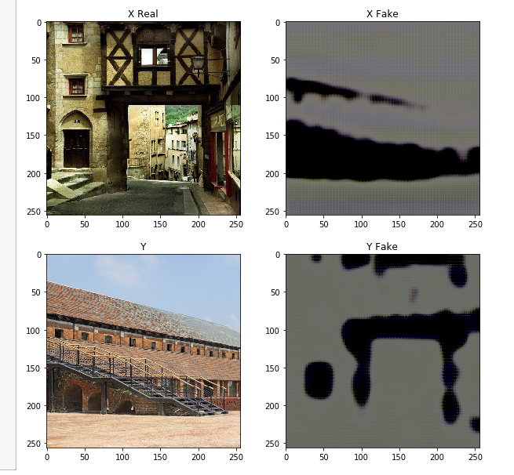
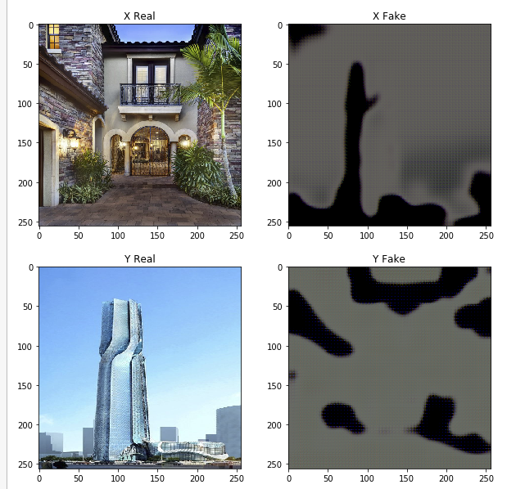
Results

Slide 12
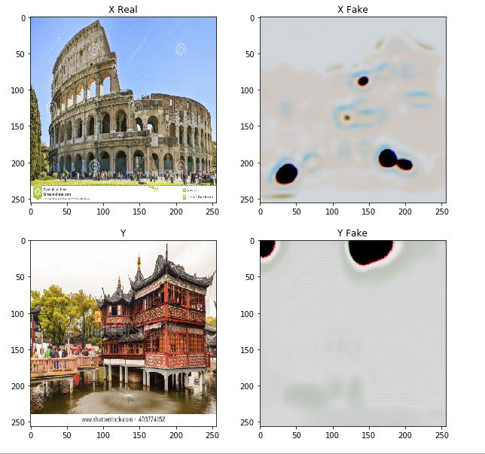
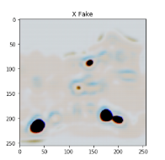
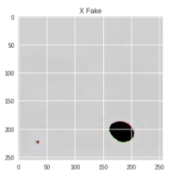
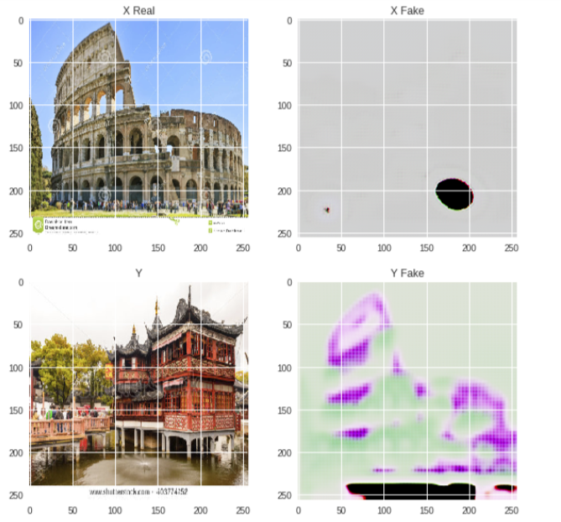
Results

Slide 13
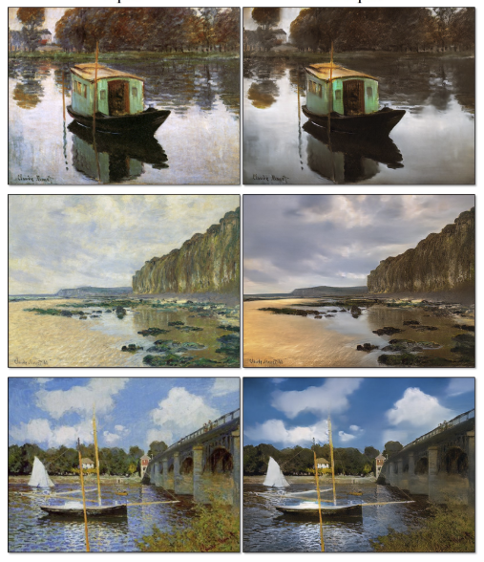
What others have implemented?
Monet Paintings ------> Landscape Photographs

Slide 14
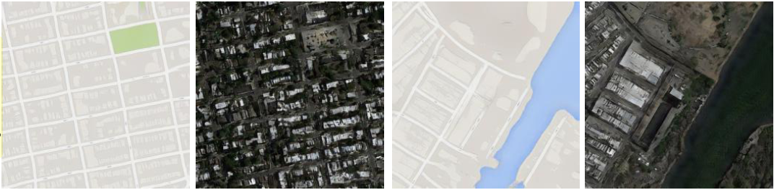
What others have implemented?
Terrain Generation

Slide 15
Project Value
Reimplemented CycleGAN in TensorFlow with modifications
Explored different applications of using CycleGAN
Tested the influence of epochs and dataset size to CycleGAN performance
Study how the concept of style transfer works on building architectures

Slide 16
Thank you
Questions?

